Slide 1
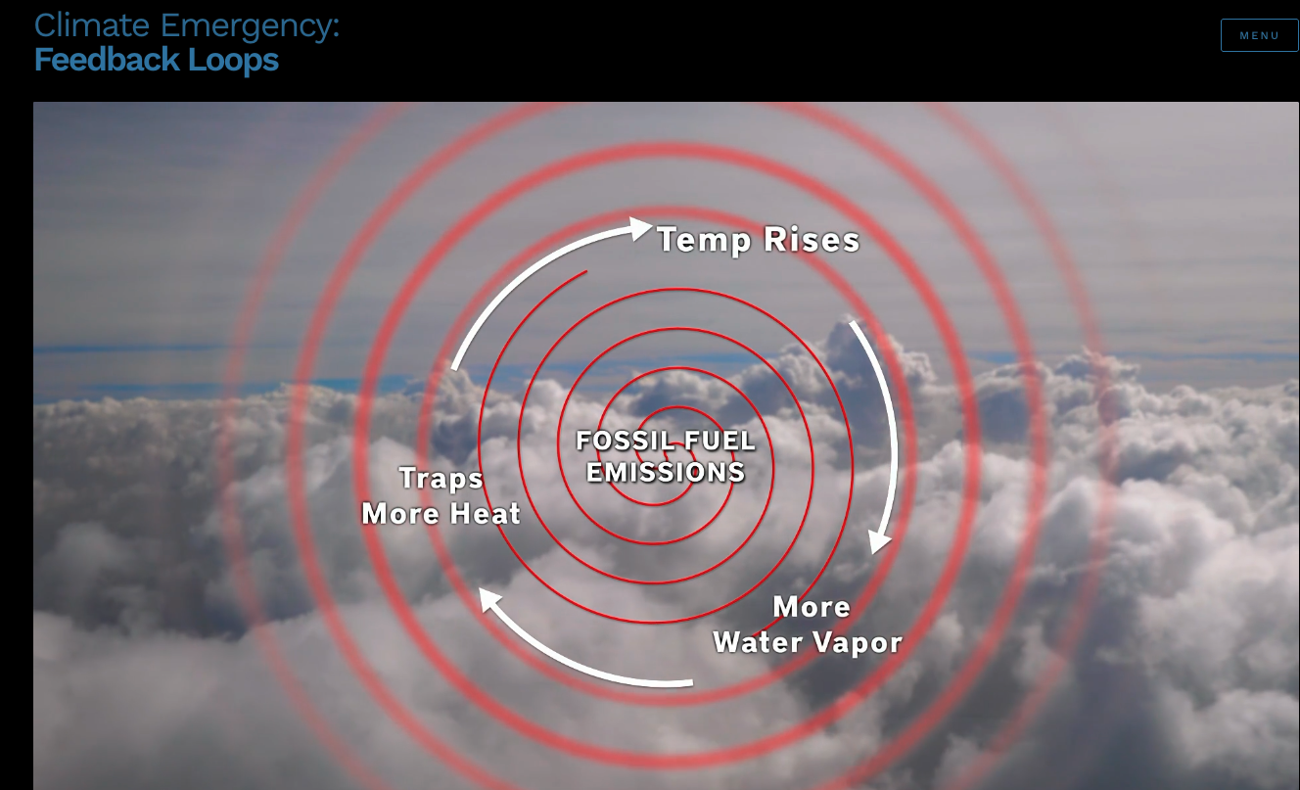
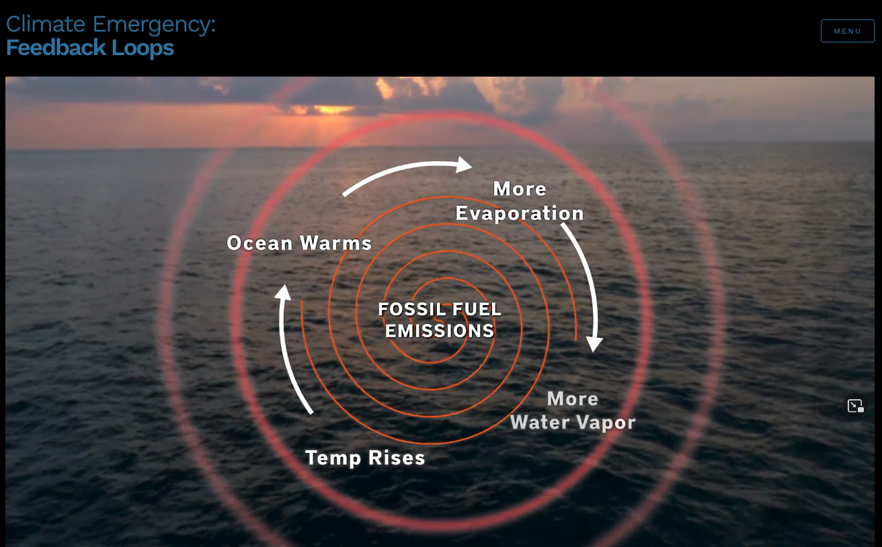
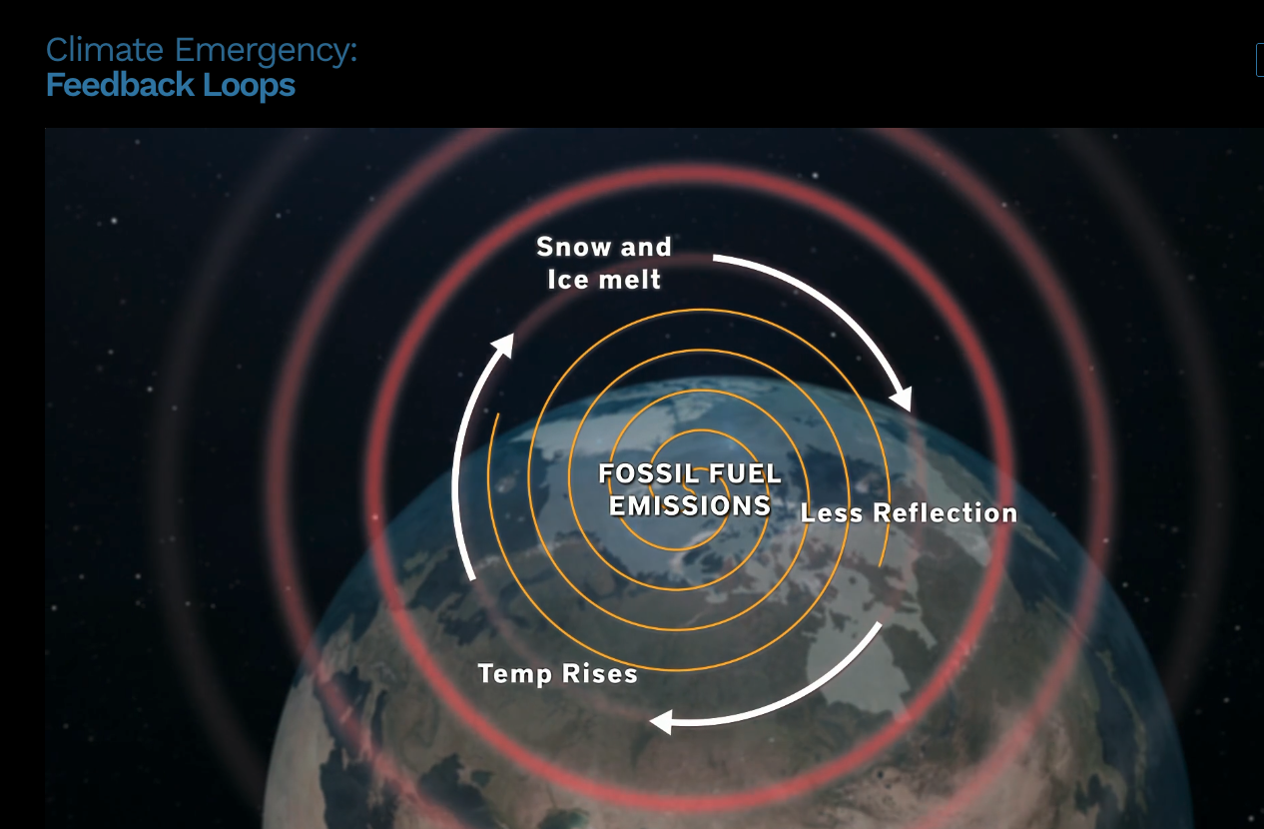
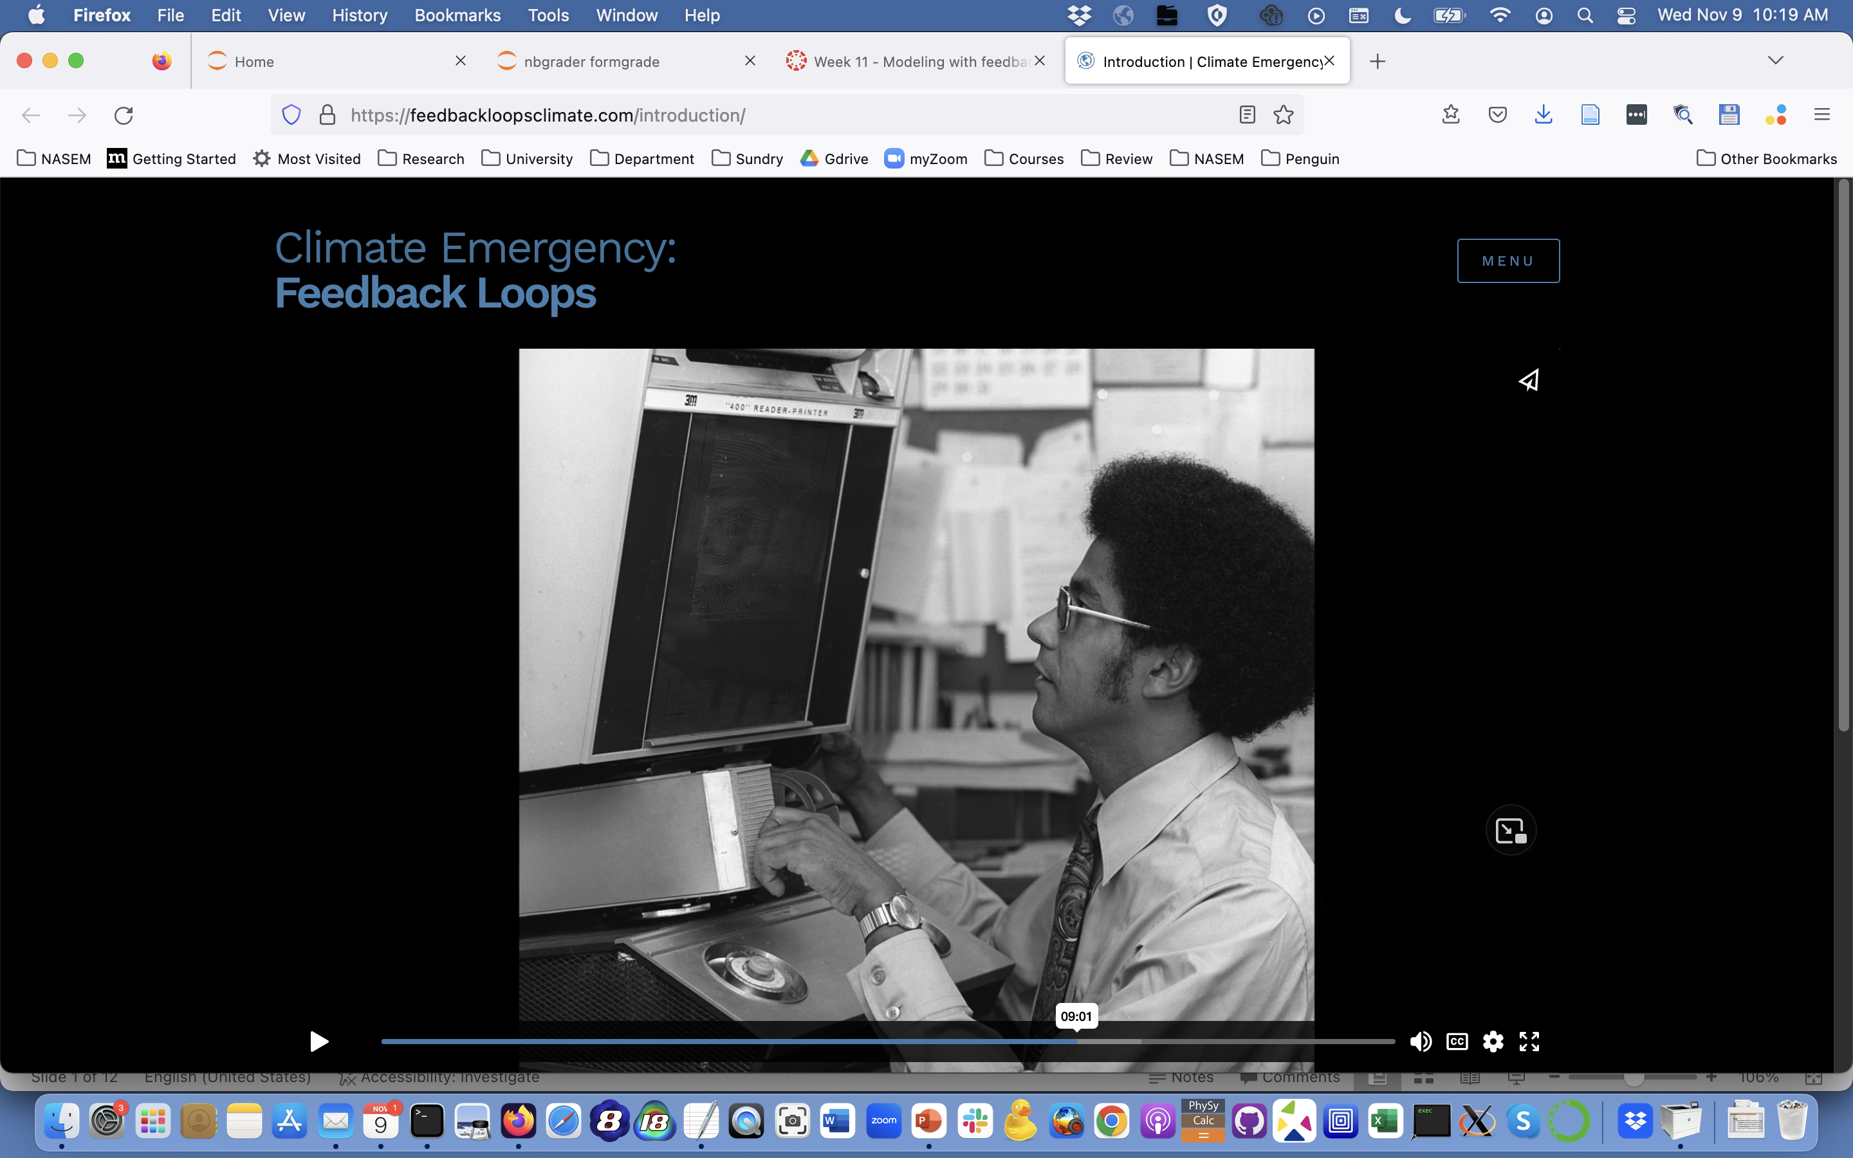
Feedback loops & synchronicity are generic properties of complex systems
Warren Washington

Slide 2
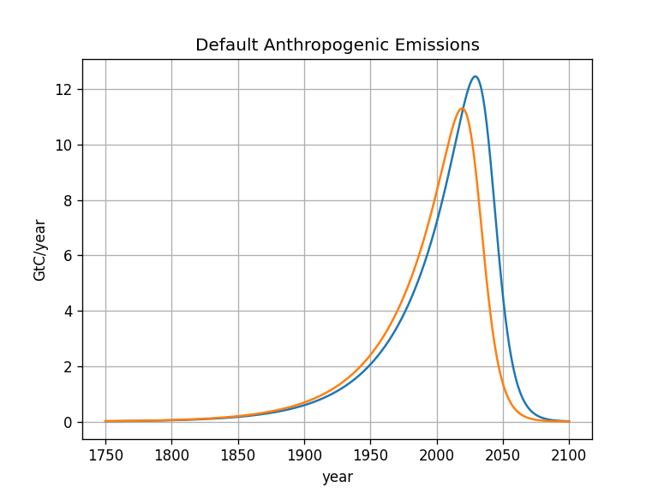
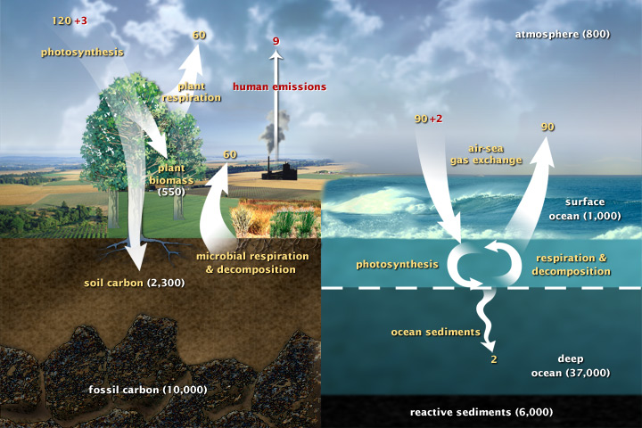
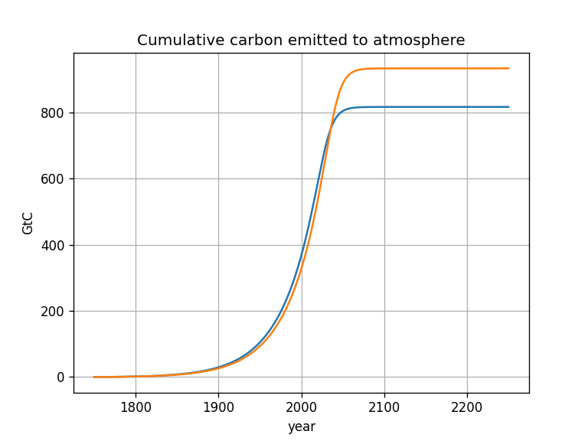
Consequences of delay

Slide 3
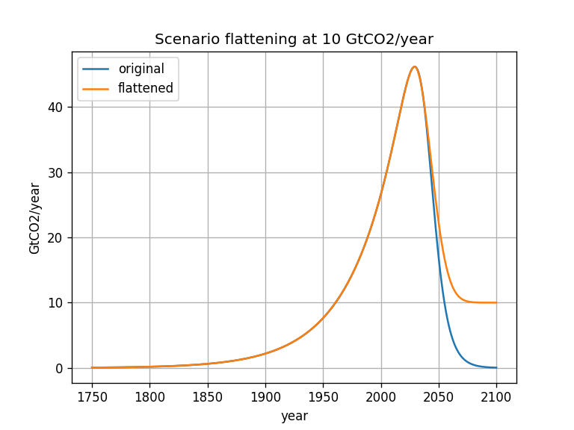
Consequences of incomplete decarbonization

Slide 4
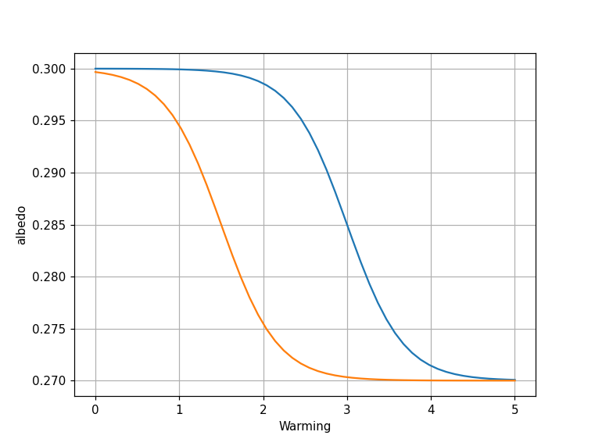
Consequences of albedo tipping point happening at a lower temperature

Slide 5
Methodology for exploring feedbacks: linear or nonlinear?
Response
Perturbation

Slide 6
Methodology for exploring feedbacks: linear or nonlinear?
Response
Perturbation

Slide 7
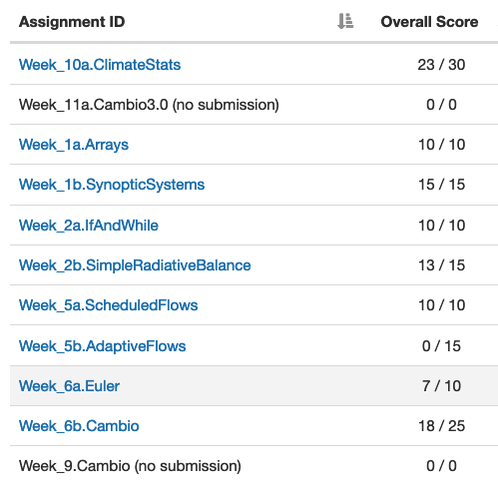
Assigning a grade for the course
Category | Significant gaps | Mostly there | Great command
CGIs
Discussion
Research Notebook
Interview
Project
All CGIs except Cambio3.1 are due midnight this Friday night, for full credit.
Cambio3.1 is due Monday night, Nov. 14 for full credit.

Slide 8
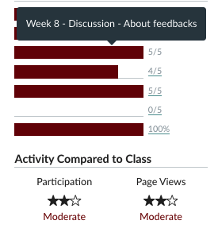
Assigning a grade for the course
Category | Significant gaps | Mostly there | Great command
CGIs
Discussion
Research Notebook
Interview
Project
You can check your submissions on Canvas

Slide 9
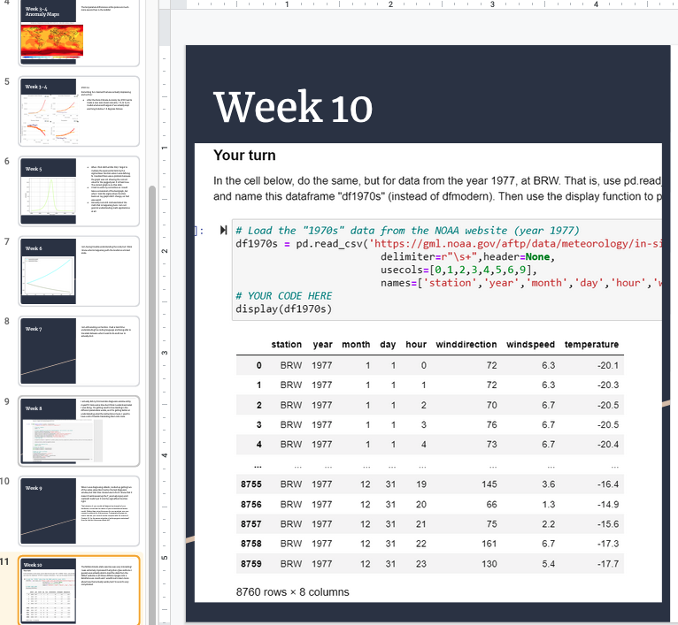
Assigning a grade for the course
Category | Significant gaps | Mostly there | Great command
CGIs
Discussion
Research Notebook
Interview
Project
I’d like you to update your research notebooks too

Slide 10
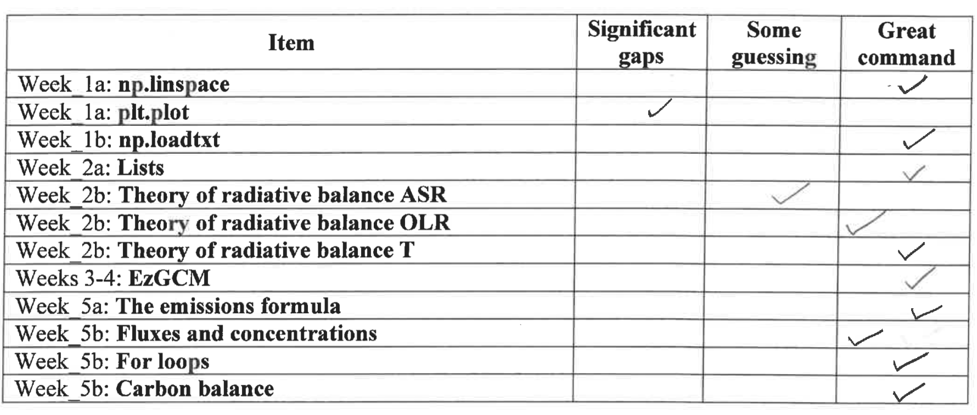
Assigning a grade for the course
Category | Significant gaps | Mostly there | Great command
CGIs
Discussion
Research Notebook
Interview
Project
We’ll be doing this again Finals Week

Slide 11
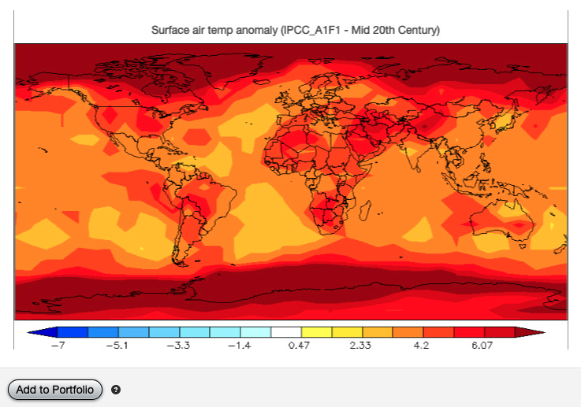
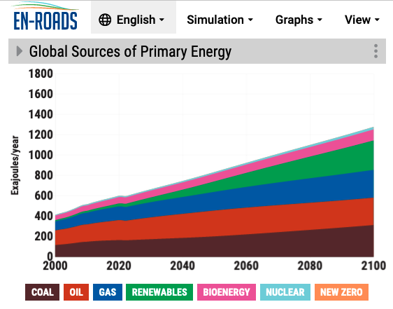
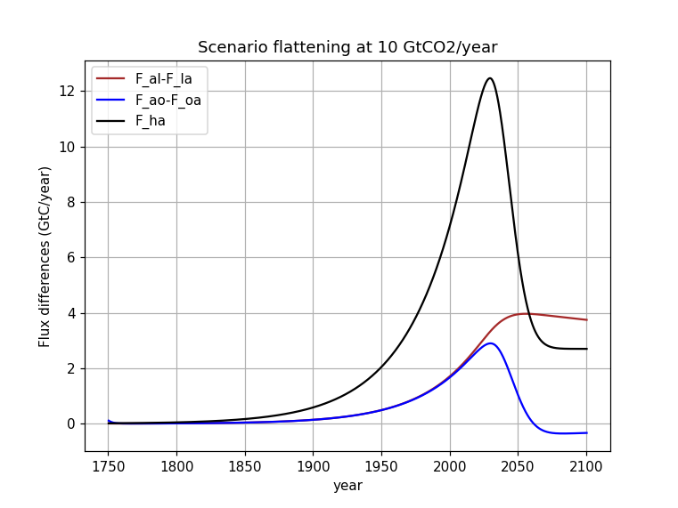
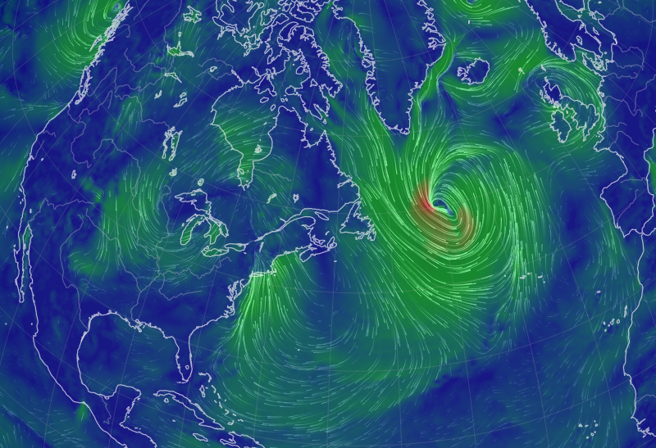
Assigning a grade for the course
Category | Significant gaps | Mostly there | Great command
CGIs
Discussion
Research Notebook
Interview
Project
15-minute Presentations:
Wednesday Nov. 30
Friday Dec. 2
Monday Dec. 5
Wednesday Dec. 7

Slide 12
Assigning a grade for the course
Category | Significant gaps | Mostly there | Great command
CGIs |  |  | x
Discussion |  | x
Research Notebook |  |  | x
Interview |  |  | x
Project |  |  | x
Looks like an “A”
Category | Significant gaps | Mostly there | Great command
CGIs |  | x
Discussion |  |  | x
Research Notebook |  | x
Interview |  | x
Project |  |  | x
Looks like an “B”

Slide 13
Assigning a grade for the course
Category | Significant gaps | Mostly there | Great command
CGIs |  | x
Discussion |  |  | x
Research Notebook | x
Interview | x
Project |  | x
Looks like an “C” or “D”
Category | Significant gaps | Mostly there | Great command
CGIs | x
Discussion | x
Research Notebook | x
Interview | x
Project |  | x
This would not be a pass

